Slide 1

Anomaly detection in Network Traffic Using
Unsupervised Machine learning Approach

Slide 2
Student Name –Prathamesh Kulkarni
Student Name –Himanshu Samariya
Student Name –Akash Sitoke
Student Name –Aman Chandre
Guided By - Prof. Sagar Dhanake

Slide 3
Project On
Anomaly detection in Network Traffic Using
Unsupervised Machine learning Approach
2021-2022
BE Computer Science

Slide 4
Anomaly detection in Network Traffic Using
Unsupervised Machine learning Approach
Topic Name

Slide 5
Content
Introduction
Review paper
Objective Of Seminar
System Overview
Project Plan
Project Implementation
System Design
Mathematical Model
Advantages
Disadvantages
Applications
Conclusions
References

Slide 6
01.Introduction
What is Anomaly Detection?
Anomaly detection is the identification of rare events, items, or observations which are suspicious because they differ significantly from standard behaviors or patterns. Anomalies in data are also called standard deviations, outliers, noise, novelties, and exceptions.
In the network anomaly detection/network intrusion and abuse detection context, interesting events are often not rare—just unusual. For example, unexpected jumps in activity are typically notable, although such a spurt in activity may fall outside many traditional statistical anomaly detection techniques.

Slide 7
There are three main classes of anomaly detection techniques: unsupervised, semi-supervised, and supervised. Essentially, the correct anomaly detection method depends on the available labels in the dataset.
In this project we have used unsupervised method for anomaly detection
Unsupervised methods of anomaly detection detect anomalies in an unlabeled test set of data based solely on the intrinsic properties of that data. The working assumption is that, as in most cases, the large majority of the instances in the data set will be normal. The anomaly detection algorithm will then detect instances that appear to fit with the rest of the data set least congruently.

Slide 8
What are Anomalies?
Anomalies can classified generally in several ways
Network anomalies: Anomalies in network behavior deviate from what is normal, standard, or expected. To detect network anomalies, network owners must have a concept of expected or normal behavior. Detection of anomalies in network behavior demands the continuous monitoring of a network for unexpected trends or events.
Application performance anomalies: These are simply anomalies detected by end-to-end application performance monitoring. These systems observe application function, collecting data on all problems, including supporting infrastructure and app dependencies. When anomalies are detected, rate limiting is triggered and admins are notified about the source of the issue with the problematic data.
Web application security anomalies: These include any other anomalous or suspicious web application behavior that might impact security such as XSS attacks or DDOS attacks.

Slide 9
What is Unsupervised Machine Learning?
Unsupervised learning, also known as unsupervised machine learning, uses machine learning algorithms to analyze and cluster unlabeled datasets. These algorithms discover hidden patterns or data groupings without the need for human intervention. Its ability to discover similarities and differences in information make it the ideal solution for exploratory data analysis, cross-selling strategies, customer segmentation, and image recognition.
Unsupervised learning cannot be directly applied to a regression or classification problem because unlike supervised learning, we have the input data but no corresponding output data. The goal of unsupervised learning is to find the underlying structure of dataset, group that data according to similarities, and represent that dataset in a compressed format.

Slide 10
Why Anomaly Detection Is Important?
It is critical for network admins to be able to identify and react to changing operational conditions. Any nuances in the operational conditions of data centers or cloud applications can signal unacceptable levels of business risk. On the other hand, some divergences may point to positive growth.
Therefore, anomaly detection is central to extracting essential business insights and maintaining core operations. Consider these patterns—all of which demand the ability to discern between normal and abnormal behavior precisely and correctly.

Slide 11
An online retail business must predict which discounts, events, or new products may trigger boosts in sales which will increase demand on their web servers.
An IT security team must prevent hacking and needs to detect abnormal login patterns and user behaviors.
A cloud provider has to allot traffic and services and has to assess changes to infrastructure in light of existing patterns in traffic and past resource failures.
A evidence-based, well-constructed behavioral model can not only represent data behavior, but also help users identify outliers and engage in meaningful predictive analysis. Static alerts and thresholds are not enough, because of the overwhelming scale of the operational parameters, and because it’s too easy to miss anomalies in false positives or negatives.

Slide 12
Review Papers
01
02
03
Aditya Vikram, Mohana
Department of Electronics &Telecommunication Engineering
RV College of Engineering®, Bengaluru, India 2020 IEEE
Alenljung, B., Lindblom, J., Anderasson, R. & T. Ziemke
International Journal of Ambient Computing and Intelligence (IJACI)
Swapneel Mehta
Dept. Of Computer Engineering,
D. J. Sanghvi College of Engineering
Mumbai, India

Slide 13

Objective of Project
We are developing an IDS(Intrusion Detection System),which helps to track and keep an eye out on the anomalous or abnormal activities in the network.Our software provides accurate results which can help to avoid any malicious attacks or intrusions by alerting the user before hand.

Slide 14

The main goal of this project is to detect anomalous points and false positives on a huge and complex data set which is highly imbalanced and contains various types of attacks using unsupervised machine learning algorithm isolation forest and and to deliver accurate results .
Scope of Project

Slide 15
2.System Overview
2.1 System Requirements
The system requirement specification of our project will have the entire necessary requirement
which will be a baseline of our project. The software requirement specification will incorporate
functional and nonfunctional requirements, system architecture, data flow diagrams, UML dia
grams, experimental setup requirements and performance metrics.
2.1.1 Hardware Requirements
A hardware interface is needed to run the software. Python IDLE and other necessary libraries
is required which is minimal requirement.
1. Processor: Pentium IV 2.6 Ghz
2. 1 GB ram
3. Monitor : 15 VGA color

Slide 16
2.1.2 Software Requirements
1. Operating System : Windows 7/8.1/10 Linux
2. Python
Features Of Python
(a) Easy to Learn and Use
Python is easy to learn as compared to other programming languages. Its syntax is straightforward and much the same as the English language. There is no use of the semicolon or curly-bracket, the indentation defines the code block. It is the recommended programming language for beginners.
(b) Expressive Language
Python can perform complex tasks using a few lines of code. A simple example, the hello world program you simply type print(”Hello World”). It will take only one line to execute, while Java or C takes multiple lines.

Slide 17
(c) Cross-platform Language
Python can run equally on different platforms such as Windows, Linux, UNIX, and Macintosh, etc. So, we can say that Python is a portable language. It enables programmers to develop the software for several competing platforms by writing a program only once.
(d) Object-Oriented Language
Python supports object-oriented language and concepts of classes and objects come into existence. It supports inheritance, polymorphism, and encapsulation, etc. The object-oriented procedure helps to programmer to write reusable code and develop applications in less code.

Slide 18
3.Project Plan
3.1 Requirement gathering
In this step we identify what are various requirements are need for our project such are software and hardware required
3.2 System Design
In this system design phase we design the system which is easily understood. We design some UML
diagrams and data flow diagram to understand the system flow and system module and sequence
of execution.
3.3 Implementation
In implementation phase of our project we have implemented various module required of success
fully getting expected outcome at the different module levels

Slide 19
3.4 Reconciled Estimates
3.4.1 Cost Estimate
Including Language learning ,Document print cost, Other Resources which will be used for project
is approximately Rs. 15,000.
3.4.2 Time Estimate
Estimate time for project is 8 months with requirement gathering, coding, testing.
3.5 Project Resources
1. Team size of students = 4
2. Resources:Software Resources
(a) OS: Windows
(b) Code Editor: Jupyter Notebook
(c) Programming Language: Python
3. Hardware Resources
(a) Laptop

Slide 20
3.6 Applications
Anomaly detection is applicable in a variety of domains such as Intrusion detection, Fraud detection, Fault detection, System health monitoring, Event detection in sensor networks, Detecting
ecosystem disturbances, Defect detection in images using machine vision It is often used in pre
processing to remove anomalous data from the dataset

Slide 21
4.Project Implementation
4.1 Introduction
Anomaly detection deals with the identification of unusual patterns/behaviour that doesn’t con
firm to the usual trend. It is applied in wide range of areas- Signal processing, Automation in
manufacturing, Chemical reaction monitoring etc. Here we will narrow down to finding anomalous data points.
4.2 Tools and Technologies Used
The Jupyter Notebook is an open source web application that you can use to create and share
documents that contain live code, equations, visualizations, and text. Jupyter Notebooks are a
spin-off project from the IPython project, which used to have an IPython Notebook project itself.
The name, Jupyter, comes from the core supported programming languages that it supports: Julia, Python, and R. Jupyter ships with the IPython kernel, which allows you to write your programs in Python, but there are currently over 100 other kernels that you can also use.

Slide 22
4.3 Algorithm Details
4.3.1 Isolation Forest
Isolation forest detects anomalies by randomly partitioning the domain space. Yeah, you’re heard
me right- It works similar to Decision trees algorithm, where we start with a root node and keep
on partitioning the space. In Isolation forest we partition randomly, unlike Decision trees where
the partition is based on Information gain.
4.3.2 Steps to Build Isolation Forest
1. Select a feature at random from data. Let us call the random feature f.
2. Select a random value from the feature f. We will use this random value as a threshold. Let
us call it t.
3. Data points where f ¡ t are stored in Node 1 and the data points where f t go in Node 2.
4. Repeat Steps 1–3 for Node 1 and Node 2.
5. Terminate either when the tree is fully grown or a termination criterion is met.

Slide 23
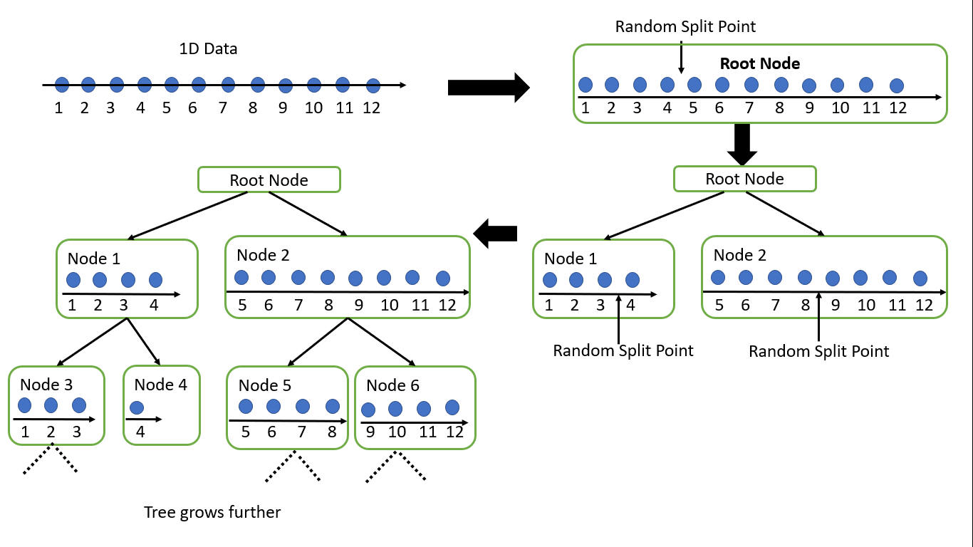
The following figure shows its mechanism for 1 Dimensional Data:
The feature to split on and threshold are chosen at random as shown in the below figure.

Slide 24
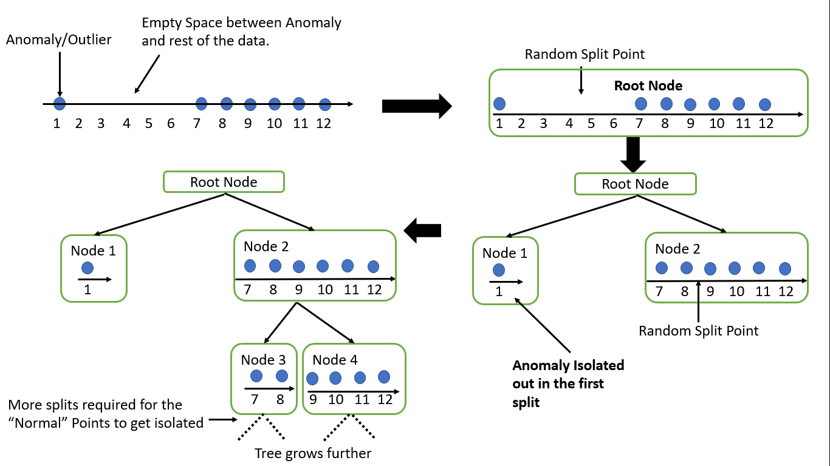
4.4 Working of Isolation Forest
Assume the data above has an anomaly. In that case, the anomalous point will be far away from the other data points. Isolation forests are able to isolate out anomalies very early on in the splitting process because the Random Threshold used for splitting has a large probability of lying in the empty space between the outlier and the data if the empty space is large enough. As a result, anomalies have shorter path lengths. After all, the split point(the threshold)is chosen at random. So, the larger the empty space, the more likely it is for a randomly chosen split point to lie in that empty region. Let us take a look at how an Isolation tree would look in the presence of an Anomaly.

Slide 25
As we can see, due to the large space between the anomaly and the rest of the data, it is very
likely that a random split will lie in this empty region.
Please note that the trees can grow either:
1. Till there is exactly one data point in each leaf node. Or
2. Till termination criterion regarding the minimum number of data points in a leaf node is
Reached.
Here is briefly how Isolation forests work:
1. Construct an Isolation Tree either from the entire feature set or a randomly chosen subset
of the feature set.
2. Construct n such Isolation trees.
3. Calculate an Anomaly score for each data point. The Anomaly score is a non-linear function
of the Average path length over all Isolation trees. The path length is equivalent to the number of splits made by the Isolation tree to isolate a point. The shorter the Average path length, the larger are the chances of the point being an anomaly(as we saw earlier in the diagram).

Slide 26

The Isolation forest in sklearn has 4 important inputs:
1. n-estimators: Number of Isolation trees trained.
2. max-samples: Number of data points used to train each tree.
3. contamination:Fraction of anomalous data points. For example, if we suspect 5% of the data to be anomalous, we set contamination to 0.05.
4. max-features:Number of features to be used to train each tree(This is in contrast to Random
Forests where we decide on a random subset of features for each split).

Slide 27
5.System Design
5.1 Introduction
Nowadays, the number of networking devices is increasing at an exponential rate, and the workplace has a lot of devices that handle sensitive data communication. In recent years, the number of unknown attacks has increased rapidly both from inside and outside the organization.
So,it has become imperative to provide customers and users secure access to the network and at the same time keeping the network attack free. There are a few different ways to avert digital attacks,one of which is by utilizing Intrusion Detection Systems.
IDS is one segment of system security that ensures information and data security, by checking the traffic on a bundle of information to identify an interruption or anomaly. The IDS used in this project is anomaly-based.
The anomaly detection or outlier detection system assume that abnormal behavior is malicious. The idea is to train the machine learning model to learn normal behavior and then look for abnormal behavior or anomalies and raise alerts accordingly.

Slide 28
Anomaly detection is perfect for such problems. IDS have been around for decades.
The initial models relied on heuristics and thresholds, which helped to reduce the false positive and false negatives.
These systems were notable to detect new attacks and due to the increasing number of wireless devices and growth of cloud computing the frequency of attacks has increased exponentially and it has become essential for companies to use a data-driven approach.
However, there are some issues associated with the machine learning-based approach.
These include detecting normal instances as false positives,which might seem benign but in reality, it leads to wastage of time and resources.

Slide 29
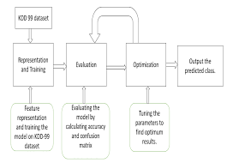
5.2 System Architecture

Slide 30
6.Results
6.1 Anomaly Score
Anomaly score is given by the following formula- where
n- Number of data points
c(n)- It is the average path length of unsuccessful search in a Binary search tree.
We grow an isolation tree by randomly choosing a feature and randomly partitioning. This is
very similar to the Binary Search tree. Thus we can approximate the average path length of for a node termination with the unsuccessful search in a Binary Search tree. Thus we use c(n) as the reference.

Slide 31
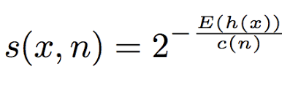

Slide 32
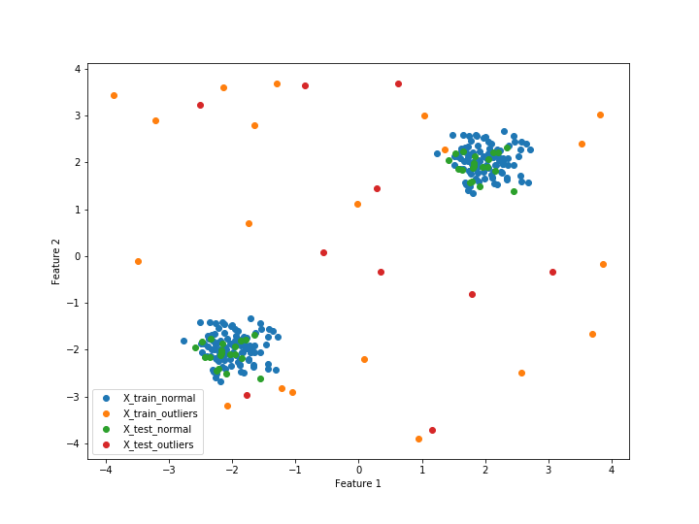
6.2 Plotting Dataset

Slide 33
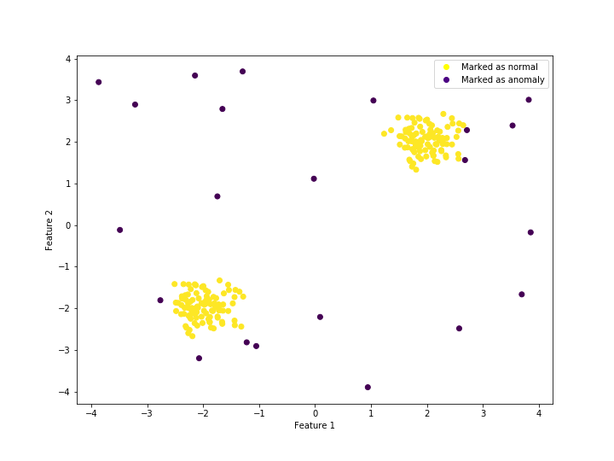
6.2 Visualising Training Predictions

Slide 34
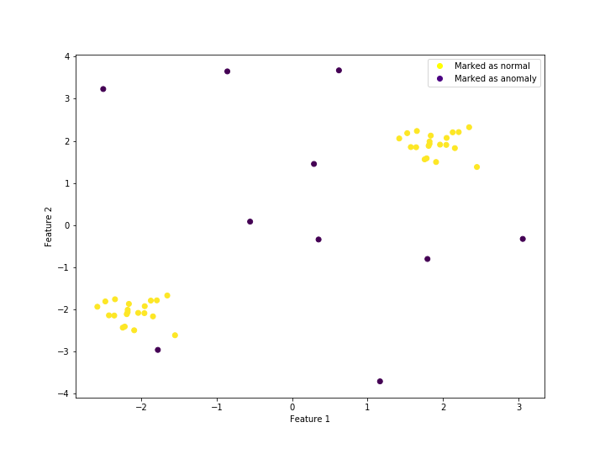
6.2 Visualising Testing Predictions

Slide 35
7.Advantages
1.Automated KPI analysis:
– For most businesses, KPI analysis is still a manual task of sorting through all of their digital channel’s data across different dashboards. Depending on how much data the company collects, this can be an incredibly time-consuming task.
– But, when using an anomaly detection system, AI algorithms are constantly scanning through all your data across all your dashboards and analysing metrics 24/7. This means you’ll no longer have to check BI tools like Google Analytics constantly to know what’s going on in your KPIs.
– Instead, the anomaly detection will alert users straight away when it finds anomalies and unusual behaviour – good or bad – in their metrics, so you can use these insights in your strategy without delay.

Slide 36
8.Disadvantages
So by using ML approach anomaly detection we can detect anomalies faster than any normal
traditional method and provide a better security to our data.
• It is not always certain that the obtained results will be useful since there is no label or output measure to confirm its usefulness.
• One cannot accurately define the sorting and output of an unsupervised task. It is heavily dependent on the model and in-turn on the machine.
• The results often have lesser accuracy.

Slide 37
9.Applications
Anomaly detection is applicable in a variety of domains such as :
Intrusion detection,
fraud detection,
fault detection,
system health monitoring,
event detection in sensor networks,
detecting ecosystem disturbances,
defect detection in images using machine vision.
It is often used in preprocessing to remove anomalous data from the dataset.

Slide 38
10.Conclusions
An unsupervised machine-learning model was built due to highly imbalanced data. The AUC score was computed is 98.3%. The “n_estimators” parameter was kept at 100. The “contamination” parameter value was 4% of the total number of samples or 0.04.
Due to a tremendous growth in different types of network attacks organizations are developing intrusion detection system that are capable of detecting false positives and false negatives and also threats in real-time,with a great amount of efficiency.
Also more complete and clean datasets provide better results.
It is important to realize that machine learning, deep learning application is fairly new in the network security domain, and therefore there are still challenges related to scalability and efficiency.

Slide 39
11.Future Scope
By combining the machine learning algorithms and preparing a hybrid the accuracy of the model can be increased.
Feature normalization and different feature selection algorithm can be used that can provide better results.
Also Deep Learning techniques have shown higher accuracy and are more robust.
Due to growing number of attacks it has become highly important to analyze and detect anomaly in real-time,which can be achieved by using user entity behavior analytics along with machine learning techniques like unsupervised and supervised approach can be used to build a hybrid system that can give better results.
In the future, the model could be improved to intake real-time data and recommend attacks due to variation in network traffic.

Slide 40
12.References
https://avinetworks.com/glossary/anomaly-detection/
https://ieeexplore.ieee.org/document/9137987
http://cucis.ece.northwestern.edu/projects/DMS/publications/AnomalyDetection.pdf
https://arxiv.org/pdf/1812.01941.pdf
https://towardsdatascience.com/unsupervised-learning-for-anomaly-detection-44c55a96b8c1
https://journalofbigdata.springeropen.com/articles/10.1186/s40537-021-00475-1
https://www.slideshare.net/PyData/unsupervised-anomaly-detection-with-isolation-forest-elena-sharova

